Slide 1
Responsibilities of Providers and Their Communication with Patients

Slide 2
Agenda
Health care providers
Patient-provider communication
Adherence & placebos
Alternative medicine

Slide 3
Health Care Providers
Three aims of a typical health care facility: Cure, care, and core
Cure: directly treating patient; typical focus of physicians
Care: providing for the comfort and wellbeing of the patient; typical focus of nurses
Core: ensure supplies and facilities continue to run; typical focus of administration
Goals of the three don’t always align
Aspects of a patient’s situation will influence which is prioritized
Age
Severity of illness
Anxiety/ mental health
Patient preference
Cost

Slide 4
We call them providers… So, what all should all health care providers provide?

Slide 5

Traditional vs. Alternative Medicine

Slide 6
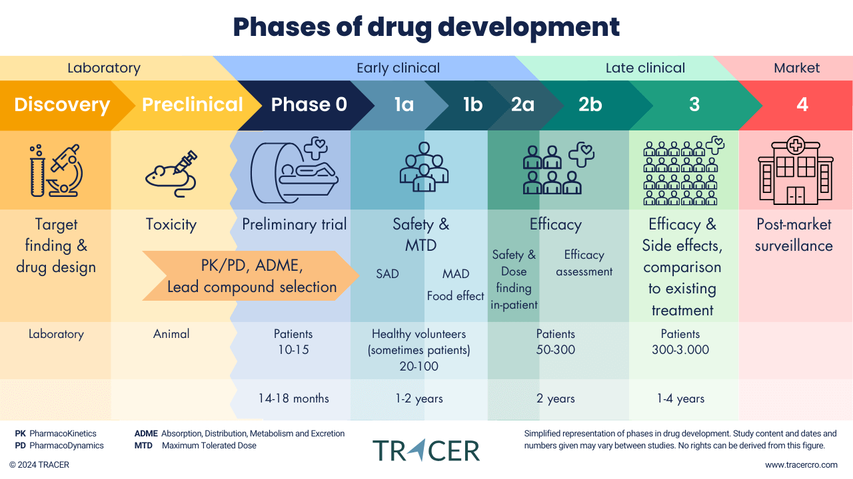
Clinical Trial Process
Note: Timeline and sample size can vary drastically

Slide 7
Alternative Medicine
Alternative medicine (also: comprehensive & alternative medicine) is composed of medical treatments and approaches that fall beyond the scope of traditional medical practices. Typically, the treatments have not been developed with empirical research, and may not be regulated by governing bodies such as the Food & Drug Administration
Many are based in a holistic approach
Traditional Chinese Medicine
Focus on the flow of qi throughout the body
Ex: acupuncture
Ayurvedic medicine
Focus on health balance, with emphasis on diet, exercise, and massage
Homeopathy & naturopathy
Homeopathy: “treat like with like”
Naturopathy: focus on fresh air, sunlight, and diet

Slide 8
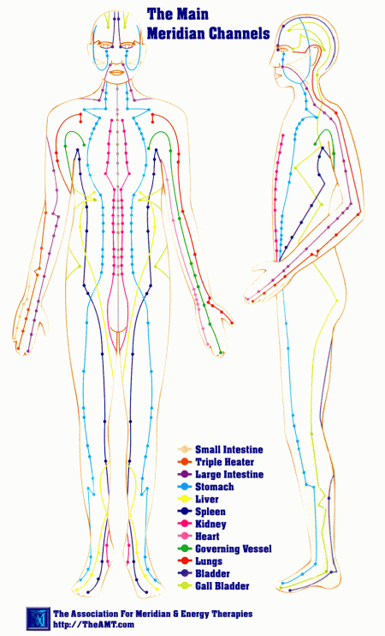
Alternative Medicine Treatments
Dietary supplements
Prayer
Acupuncture
Yoga
Hypnosis
Meditation and guided imagery
Massage
Chiropractic medicine (semi-alternative)
Arguably best option: integrative medicine
Remember the biopsychosocial model

Slide 9


Patient-Provider Communication

Slide 10
Health Care Communication
Multiple factors impact patient-provider communication:
Setting
Language/ culture
Gender
Illness and its severity
Biases
Potential breakdowns in communication:
Inattentiveness
Use of jargon
Baby talk
Patient depersonalization
Stereotyping patients

Slide 11
The Importance of Communication
Treatment adherence – following the prescribed guidelines
Accurate and efficient treatment (or specialist recommendations)
Communication with patients’ families helps facilitate patient understanding and treatment adherence
Improving communication:
Training providers
Ex: body-language, bedside manners, how to find the balance in knowledge per patient, etc.
Training patients
Ex: creating a list of questions/ concerns before treatment

Slide 12
Potential Problems
Adherence
Directly related to health outcomes (up to and including death)
Adherence rates range between 15% and 93% (though adherence is typically over-inflated)
Creative nonadherence (modifying or supplementing) is a common example
Placebo effect
Can happen at chemical and physical level
Ex: useless drug improving asthma in 33% of children in the study
Ex: sham knee surgery reducing pain ratings as much as real surgery
People want to feel better, so they do
Can complicate the interpretation of any treatment

Slide 13
Next Time on PSY 440…
Before Next Class:
Complete today’s journal prompt
Due 3/4 at 11:59 pm
In Our Next Class:
Class activity!

